Slide 1
Designing a Poster to Tell Your Story

Slide 2
The Story
Every poster tells a story
Set the stage for the story.
State your goals.
Say what you did / how you did it.
And then, what happened?
What did you learn, and what are the implications?
Background
Objectives
Methods
Results
Conclusions

Slide 3
Content of the Story
Background
Objectives
Methods
Results
Conclusions
These are all included in your abstract,
which represents the “skeleton” of your story.
Your poster will start from this skeleton …
… and make your story come alive.

Slide 4
Focusing Your Story
If a viewer can absorb only one
take-home message from your poster,
what do you want that message to be?
Identify your take-home message,
focus your story on the message,
and design your poster to deliver the message.

Slide 5
What Size Is Your Poster?
What Size Is Your Poster?
Before you start to design your poster,
find out exactly what size it must be.
Your poster must comply with width and height specifications for the poster session in which you plan to present.
These specifications will place constraints on how you communicate your story.
Once sized, you cannot just blow up a poster.

Slide 6
One size does not fit all.
There is no standard set of poster specifications.
Every meeting has its own requirements.
42 x 56
48 x 48
48 x 96
31 x 55
36 x 60
42 x 60
30 x 60
36 x 72
42 x 84
36 x 48
50 x 34

Slide 7
Size Specifications for N243 Posters
Your Story Here
42” high
48” wide

Slide 8
Poster Layout
Determined by:
The information you want to communicate
(the story)
The space available for communicating
(poster size)
+

Slide 9
Layout: Can’t We Just Use
Someone Else’s Template?
Only if …
Dimensions of the template exactly match the poster size requirements for your meeting, and
Layout of the template readily accommodates the content of each section of your poster, and
It is legally permissible for you to use that template when designing your poster.

Slide 10
Problems with Templates
Don’t consider using a template if its width and height are not an exact match for the sizes required by your poster session.
Even if the template is the right size, forcing your story into a generic layout will:
require much more time and effort than expected
produce a poster that tells your story less effectively than a poster that you design yourself

Slide 11
How Viewers Read a Poster
Title:
L → R
2
Title
3
5
7
Within columns:
Up → Down
Across columns:
L → R
1
Design your poster accordingly.
4
6

Slide 12
Possible Layouts – Column Format
Balance the major sections of the poster if possible.
Use a layout that suits the content of YOUR poster.

Slide 13
Place text where viewers will expect it.
Title of Your Poster
Author, Affiliation
Background
Results
(Findings)
Conclusions
Insert as appropriate:
Objectives
Diagrams
Pictures
Methods
Procedures)
Graphs
Tables
References
Acknowledgments

Slide 14
The word “serif” means “tail” in French.
Fonts
No “tails” in these fonts:
Two categories of font styles:
Serif
Sans-Serif
Times New Roman
Century Schoolbook
Garamond
Palatino Linotype
Arial
Calibri
Tahoma
Verdana
Be consistent in your use of fonts.

Slide 15
Be consistent in your use of fonts
Mix fonts sparingly, if at all. For example, use a serif font for a title and a sans serif for body copy.
You must choose one font size for heads, a smaller one for text, perhaps a smaller size for info in tables. Be consistent. Readers link size to importance like this:
Very important
Somewhat important
Least important

Slide 16
Minimum font size
Every word should be readable at a distance of 3 to 4 feet from the poster
View your poster at 100% to check the size of the fonts and the resolution of graphics
Picture or table captions can be a bit smaller. Arial Narrow is a great choice for tables.

Slide 17
Average amount of time viewers spend scanning a poster:
11 seconds
Maximum amount of time viewers spend reading a poster if they are passionately interested:
10 minutes

Slide 18
So, edit your text ruthlessly!
“Need to know”? Keep it in (but edit!)
“Nice to know”? Delete it entirely*
*Reserve for a discussion with viewers who are really interested.
Only text relevant to your take-home message should remain on the poster.

Slide 19
Make your text easy to read
No large chunks of text—people won’t read them
Use bulleted phrases instead of sentences
Use numbers ONLY when sequencing items
Standardize the size, style, and indentation of bullets
(may use different bullet styles/sizes for different levels of text)
Don’t hyphenate or break text in a phrase:
“with this ring I thee wed” not
“with this ring I
thee wed”
Left justify the text. It’s easier to read
Keep lots of open space around text—don’t crowd

Slide 20
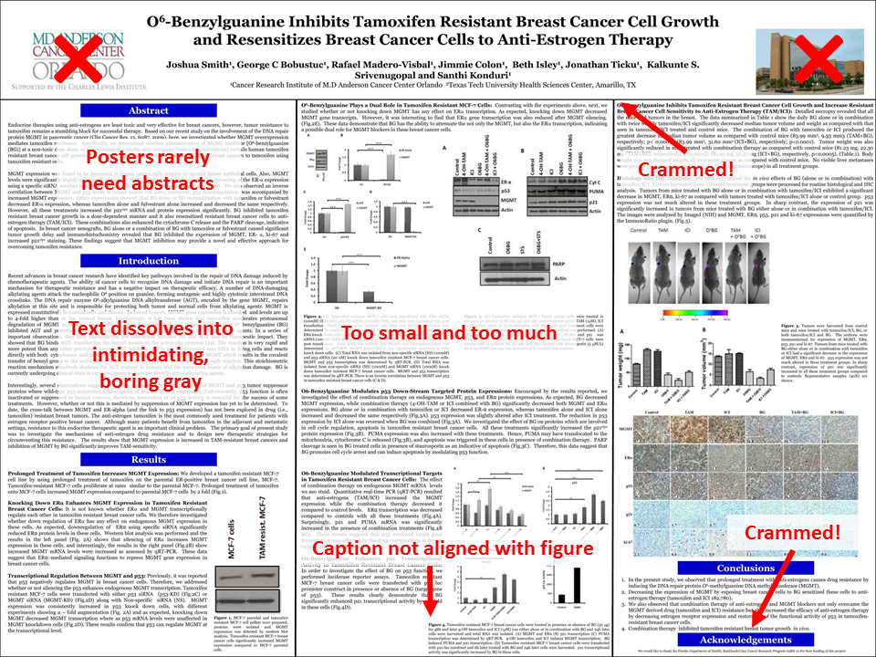
Too much text!
http://betterposters.blogspot.com/2011/04/critique-breast-cancer-inhibition.html

Slide 21
Color Scheme
Background ● Text ● 1 or 2 accent colors
Optimal: Light background with dark text
Dark background with light letters can be difficult to read if your font is not large or bold enough.
Contrast is critical!
Contrast is critical!
Contrast is critical!
Contrast is critical!

Slide 22
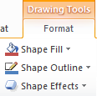
Sample Poster Design with
Dark Background / Light Panels
Insert a rectangular shape to create each panel. In this example, each of the 3 vertical panels has exactly the same dimensions
Create a text box with standard font sizes & style, then duplicate it and change text.
Title of Your Poster
Author, Affiliation
Background
Results
or Findings
Conclusions
Objectives
Use the Format “Align” function to adjust alignment of panels and alignment of text boxes within panels.
In this example, panels have
white “shape fill” and golden-yellow “shape outline”
Methods
or Procedures
References
Acknowledgements
Can use slightly smaller font for headers References & Acknowledgements sections

Slide 23
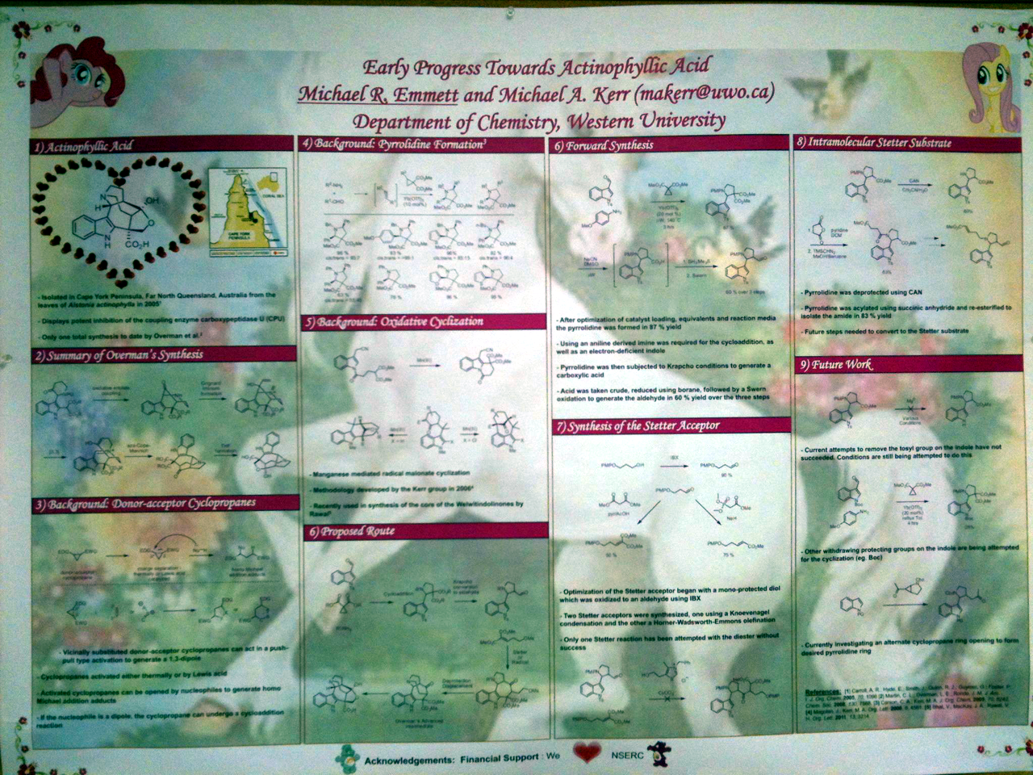
It’s about your info, not the background
Busy background makes words almost unreadable
Cognitive dissonance between content & background
Source: http://betterposters.blogspot.com/

Slide 24
Color choices
Experiment with different schemes
If colors are used to identify specific themes or groups, use color consistently throughout the poster
Colors help the viewer to spot similar items and navigate content
YOU need to be satisfied with your color scheme, because you will be standing in front of the poster!

Slide 25
Adding pictures
Downloading photos and figures from the web is not advised.
Web images usually have poor resolution (typically 72 or 96 dpi). 300 dpi is needed!
Do not use copyrighted images without permission!
Ask our staff, take your own or consider purchasing stock photos

Slide 26
Resolution
300 dpi
150 dpi
72 dpi
Minimum acceptable resolution: 300 dpi
Check out graphics and photos at 200% or 400%. If fuzzy or pixilated, resolution is not acceptable.

Slide 27
Print out your poster and proof it!
Your poster WILL have some errors, and it is hard to spot errors onscreen
Display poster to others for proofing… “It takes a village.”
Allow ample time for corrections!

