Slide 1
Sickle Cell Disease: Core Concepts for the Emergency Physician and Nurse Acute Chest Syndrome Case Study
David M. Cline, MD
Wake Forest School of Medicine
Paula Tanabe, PhD, RN, FAEN, FAAN
Associate Professor
Duke University, Schools of Nursing and Medicine

Slide 2
Objectives
Identify recommended antibiotics for patients with sickle cell disease (SCD) diagnosed with acute chest syndrome (ACS)
Identify indications for simple & exchange transfusion in patients with SCD admitted with ACS

Slide 3
Pretest- Question 1
What are the recommended antibiotics for patients with SCD diagnosed with ACS?
Levofloxacin IV
IV cephalosporin, and an oral macrolide antibiotic
Vancomycin plus piperacillin/tazobactam IV
Doxycyline IV

Slide 4
Pretest- Question 2
What are in the indications for simple transfusion in patients with SCD with ACS?
Drop in hemoglobin of 1.0 g/dL below baseline
Drop in hemoglobin of 2.0 g/dL below baseline
Failure achieve a pulse oximetry reading of greater than 98%.
Failure achieve a pulse oximetry reading of greater than 95%.

Slide 5
History of the Present Illness
31 year old black male with SS SCD presents the ED with complaint of “pain crisis”
The patient states this episode is identical to his typical pain crisis, where he experiences pain in his chest, his abdomen, & both of his upper lateral thighs
The pain began yesterday, & has not responded to his oral pain medication, Dilaudid 4 mg tabs, 1 every 4 hours as needed for pain

Slide 6
Past Medical History
Additional past medical history includes avascular necrosis of both hips, priapism, NSTEMI, cholecystectomy, & one prior episode of acute chest syndrome
He smokes cigarettes, ¼ pack per day, & drinks beer occasionally
The patient averages 1 visit to the ED every month, & he is admitted to the hospital approximately 50% of the time

Slide 7
Physical Exam
Triage vital signs include temperature of 99.6ºF, blood pressure of 113/65 mm Hg, pulse 98 bpm, respirations 20/min, oxygen saturation of 93% on room air
General: he appears acutely in pain
HEENT is within normal limits except for mild icterus of the conjunctiva
Lungs clear to auscultation & percussion
Heart: heart rate & rhythm regular, no murmurs, no gallop, no rubs

Slide 8
Physical Exam-Continued
Abdomen: soft with diffuse tenderness that is similar to what had been described previously in his medical record
Extremities: He is tender over both hips & lateral thigh areas as previously described in the record. His peripheral pulses are intact
Neuro: He is alert & oriented, CN 2-12 intact, sensation 5/5 & motor strength 5/5 through-out

Slide 9
Emergency Department Course
The patient is placed on oxygen & IV fluids
The patient is given several doses of pain medication to relieve his significant pain.
Laboratory analysis reveals a white blood cell count of 17,000, with segs of 66.7%, Bands 1.76%, lymphs 25.8%, hemoglobin of 8.9 (at baseline for this patient).
Chest X-ray is ordered; shows the following subtle finding (see next slide)

Slide 10
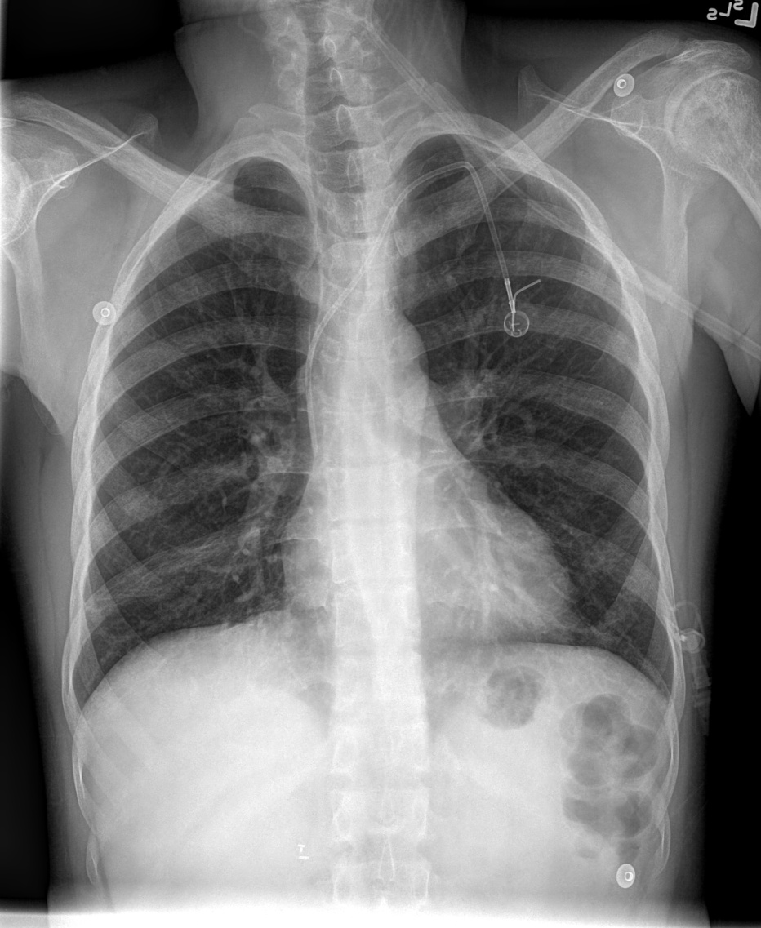
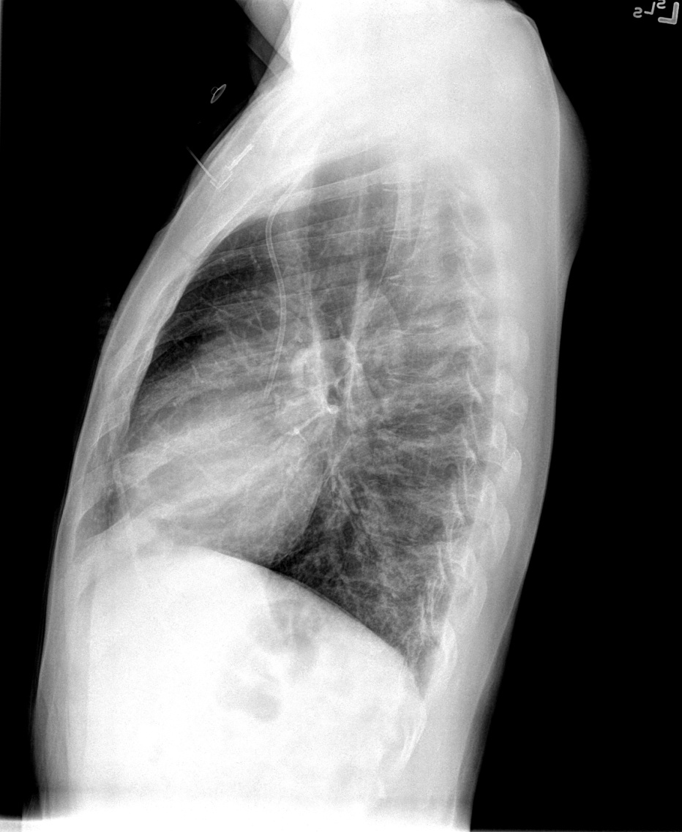
Chest X-ray
Radiology: “Basilar opacity over right base, best seen on the lateral film.

Slide 11
Hospital Course
The patient is started on intravenous ceftriaxone, & azithromycin for atypical organisms
12 hours after admission, the oxygen saturation drops to 89%. In preparation for exchange transfusion, it is noted that the hemoglobin has dropped 1 gram from initial reading
The patient is transferred to ICU, & exchange transfusion is started. He recovers uneventfully

Slide 12
Discussion
The patient has 3 risk factors for acute chest syndrome:
SS disease
Currently smoker
Prior history of acute chest syndrome
Because the patient frequently complains of chest pain with his uncomplicated vaso-oclusive crisis, differentiating acute chest from uncomplicated pain crisis is difficult. Because the findings on chest x-ray are often subtle, especially initially, comparing the current film to prior films is essential

Slide 13
Discussion- Continued
Additional red flags: temperature of 99.6°F, SPO2 of 93% on RA, white blood cell count of 17,000
The patient deteriorated after admission as recognized by his dropping oxygen saturations and hemoglobin. This is a common course with acute chest syndrome & therefore admitted patients with sickle cell disease should carefully monitored
Guidelines suggest selection of IV cephalosporin, and an oral macrolide antibiotic to treat infection.

Slide 14
Discussion- Continued
Guidelines suggest giving simple transfusion (10 mL/kg RBCs) to improve oxygen carrying capacity for patients with symptomatic ACS whose hemoglobin concentration falls 1.0 g/dL or more below baseline. If baseline Hgb is 9 g/dL or greater, simple blood transfusion may not be required
Urgent exchange transfusion is recommended when there is rapid progression of ACS as manifested by oxygen saturation below 90% despite supplemental oxygen, increasing respiratory distress, progressive pulmonary infiltrates, and/or decline in hemoglobin concentration despite simple transfusion. In these cases, consult hematology and/or critical care, and/or apheresis specialists to provide therapy.

Slide 15
Case Scenario
Cut and paste the link below into your browser to view this short video
https://www.youtube.com/watch?v=urmg_fJ289c&feature=youtu.be

Slide 16
Posttest- Question 1
What are the recommended antibiotics for patients with SCD diagnosed with ACS?
Levofloxacin IV
IV cephalosporin, and an oral macrolide antibiotic
Vancomycin plus piperacillin/tazobactam IV
Doxycyline IV

Slide 17
Posttest- Question 2
What are in the indications for simple transfusion in patients with SCD with ACS?
Drop in hemoglobin of 1.0 g/dL below baseline
Drop in hemoglobin of 2.0 g/dL below baseline
Failure achieve a pulse oximetry reading of greater than 98%.
Failure achieve a pulse oximetry reading of greater than 95%.

Slide 18
Posttest Answers & Rationale
Question 1
Answer : b) IV cephalosporin, and an oral macrolide antibiotic.
Rationale: NHLBI expert panel recommendations suggest use of IV cephalosporin, and an oral macrolide antibiotic
Question 2
Answer: a) Drop in hemoglobin of 1.0 g/dL below baseline
Rationale: NHLBI expert panel recommendations suggest simple transfusion for patients with a drop in Hgb of 1.0 gm/dl below baseline. In addition patients with ACS and a drop in oxygen saturations below 90% should receive an exchange transfusion (see other indications in discussion above). Oxygen saturations above 90% should be maintained in the patient with ACS

Slide 19
References
National Heart, Lungs, And Blood Institute. (2014). Evidenced-based management of sickle cell disease. National Institute of Health. Retrieved fromhttp://www.nhlbi.nih.gov/sites/www.nhlbi.nih.gov/files/sickle-cell-disease-report.pdf

